Slide 1


Slide 2
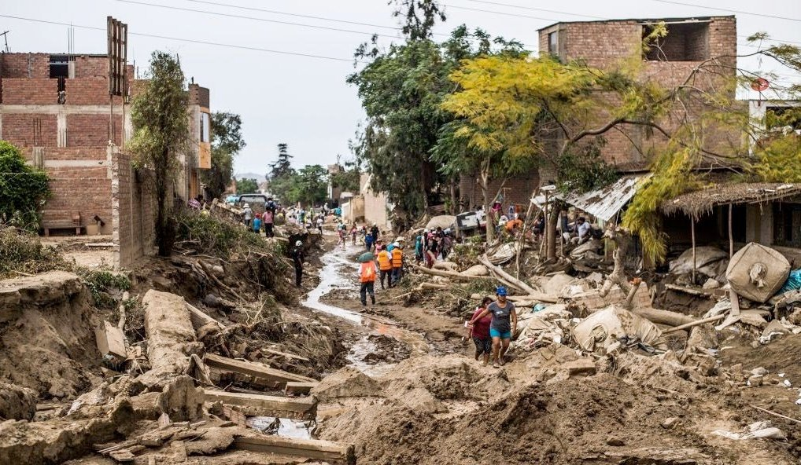
Peru, 2017

Slide 3
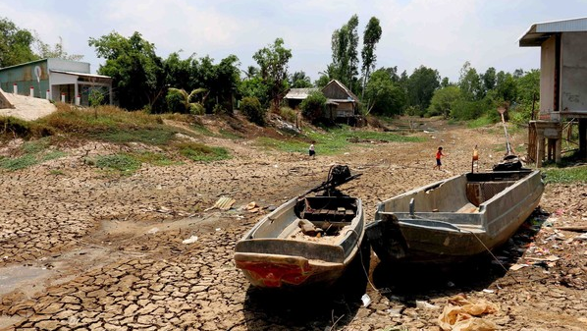
Vietnam, 2017

Slide 4

Sub-Saharan Africa, 2017
Notes:
Five years ago, governments saw the disaster coming but failed to take early action to abet the food crisis unfolding in Africa. 258,000 lives were lost which might otherwise have been saved. But this widely acknowledged failure of the international humanitarian system doesn’t have to repeat itself.
“If we act now with …..

Slide 5
The Incredibles and…
Finding Niño

Slide 6
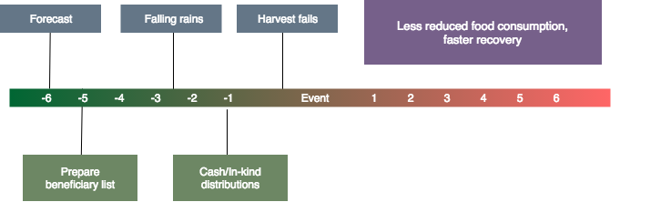
Solution
Forecast-based mitigation action plan:
Notes:
Forecast-based mitigation action plan:
Triggering system: probability of El Niño happening
Severity level of El Niño per region
Make impact visible across countries
Early action:
Reduce humanitarian losses
Risk financing: for every one $1 in mitigation you save $6
Social protection

Slide 7
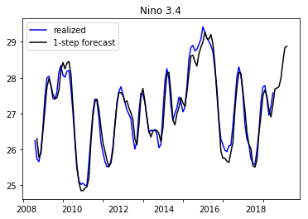
Notes:
Our Models includes:
1. Novel Forecasting Scheme to predict El Nino severity levels per region
2. Machine Learning Algorithm to allocate funding and estimate number of affected people per country

Slide 8
